Slide 1


Presentation
on
NRW Commercial losses in KUKL Supply area.
Presented By:
(Name)
(Title)
(Division/Department)
Kathmandu Upatyaka Khanepani Limited

Slide 2
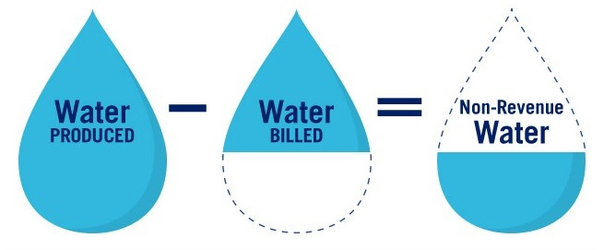
What is NRW ?

Slide 3
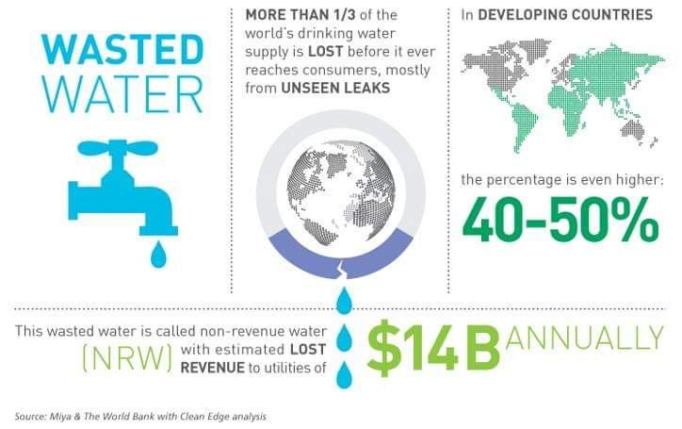
Notes:
In most developed countries, there are no or very limited apparent losses.
For developing countries the World Bank has estimated that, on average, apparent losses - in particular theft through illegal connections - account for about 40% of NRW.
A water audit is a key tool to assess the breakdown of NRW and to develop a program for NRW reduction.

Slide 4
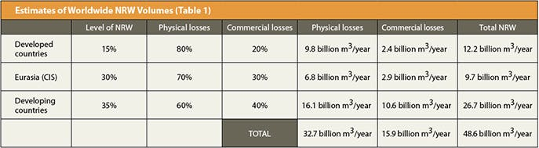
World Bank Data

Slide 5
























Leaks (लिकेज )
REAL LOSSES (बास्तबिक चुहावट) i.e Physical losses of water from the distribution system.
Main Breaks (ठुलो पाइप लिक हुनु )
NRW is clean, treated drinking water delivered to the distribution system but not billed to customers.
Meter Errors
APPARENT LOSSES (अप्रत्यक्ष चुहावट) i.e Non-physical losses that consist of water successfully delivered but not measured or recorded accurately.
NRW also includes necessary but unbilled activities such as firefighting, hydrant flushing, municipal construction, and street sweeping
Theft (चोरी)
Billing
Errors
(बिलिंग गर्दा त्रुटी )
Tank Overflows (ट्यांकी ओभरफ्लो )
Source : Tata & Howard, Inc. (www.tataandhoward.com)

Slide 6
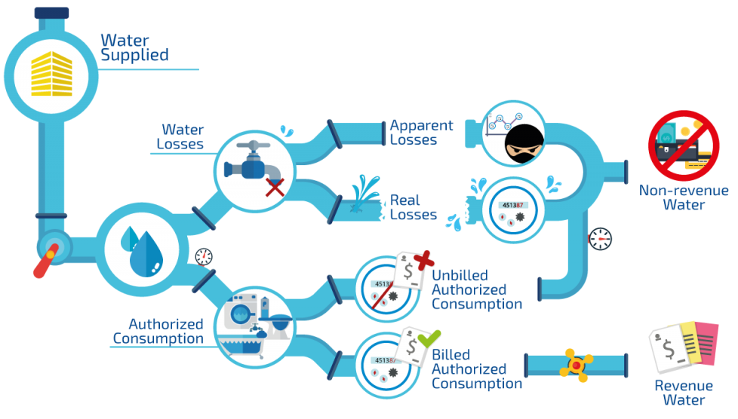
Non-Revenue Water को परिभाषा
(System मा पठाइने पानी)
(अप्रत्यक्ष चुहावट)
(चुहावट)
(बास्तबिक चुहावट)
(बिलिंग नभएको अधिकृत खपत)
(अधिकृत खपत)
(बिलिंग भएको अधिकृत खपत)
नोट: भुक्तान नगरिएको bill अप्रत्यक्ष चुहावट होइनन्।
Source : Open International (openintl.com)

Slide 7
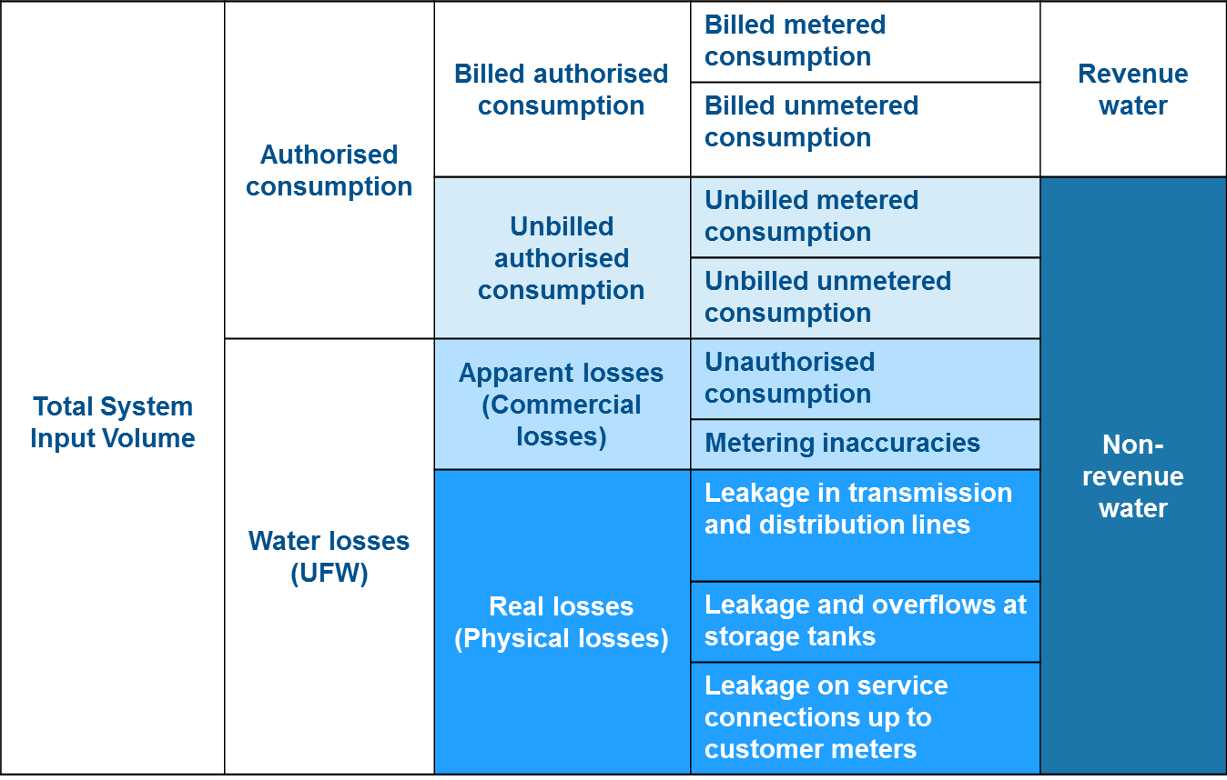


Commercial losses

Slide 8
Key Components of Commercial Loss in KUKL
Commercial Loss
Unauthorised Consumption
Meter Inaccuracies
Meter Reading Errors
Accounting Errors

Slide 9
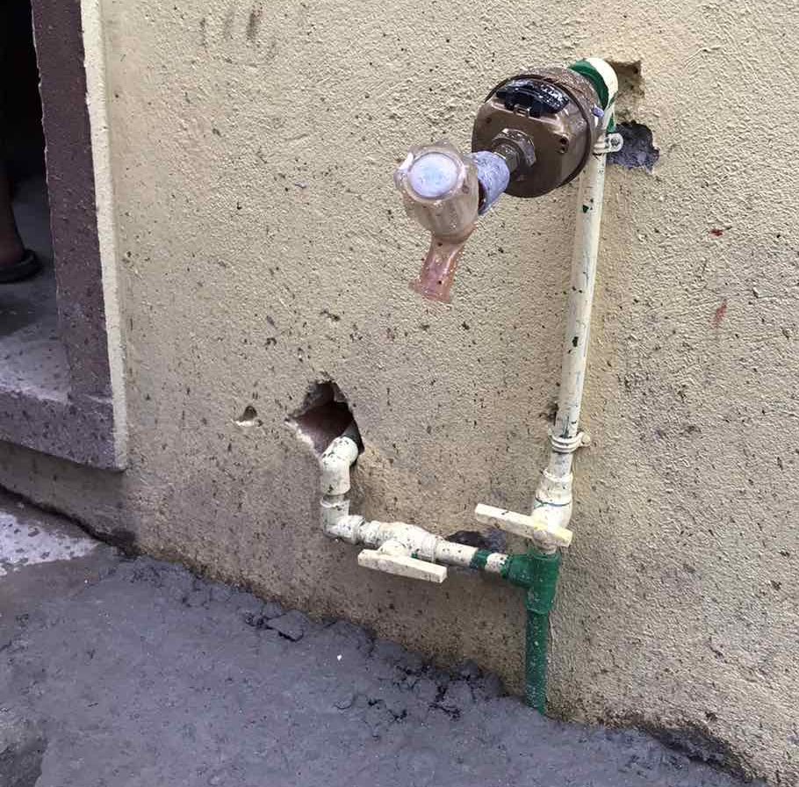
Unauthorised Consumption
Legitimate connections that were never entered into the billing system and are therefore never invoiced (intentional and accidental)
Permanent or temporary meter bypass
Illegal connections
Illegal use of fire hydrants

Slide 10
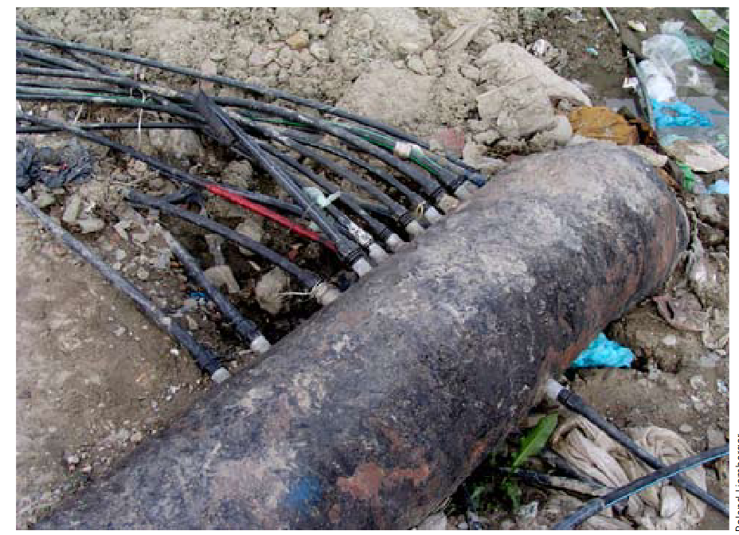
Illegal connection from transmission pipe

Slide 11
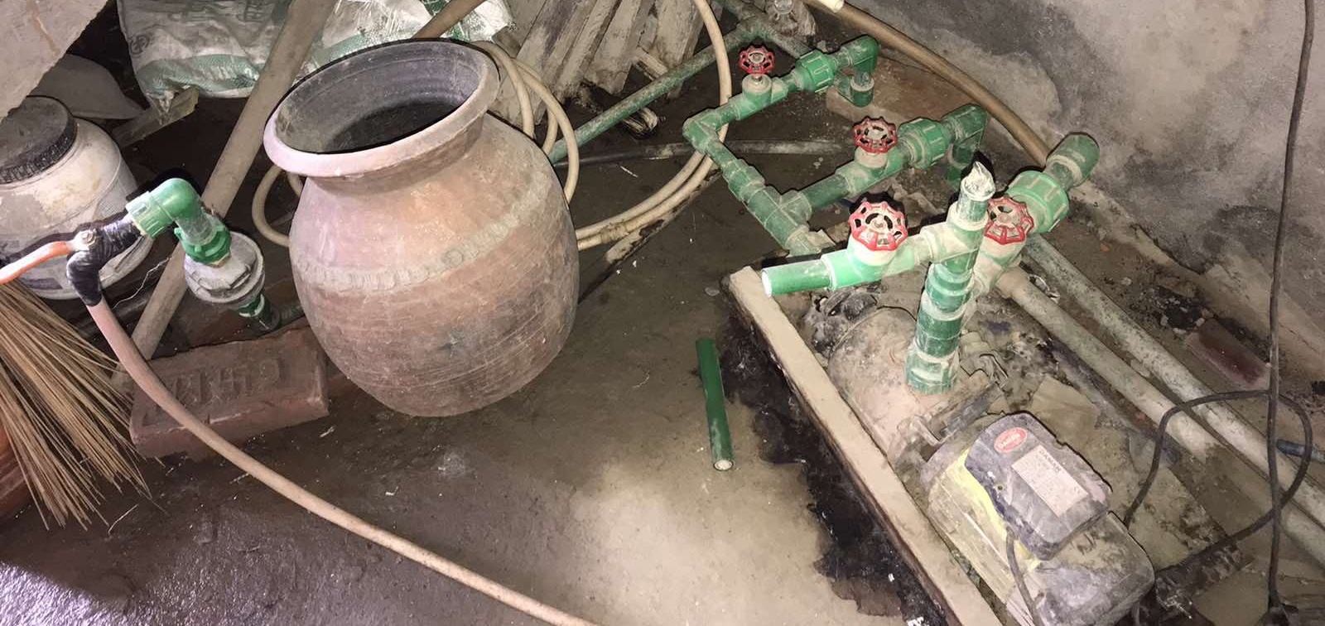
Connection at Home

Slide 12
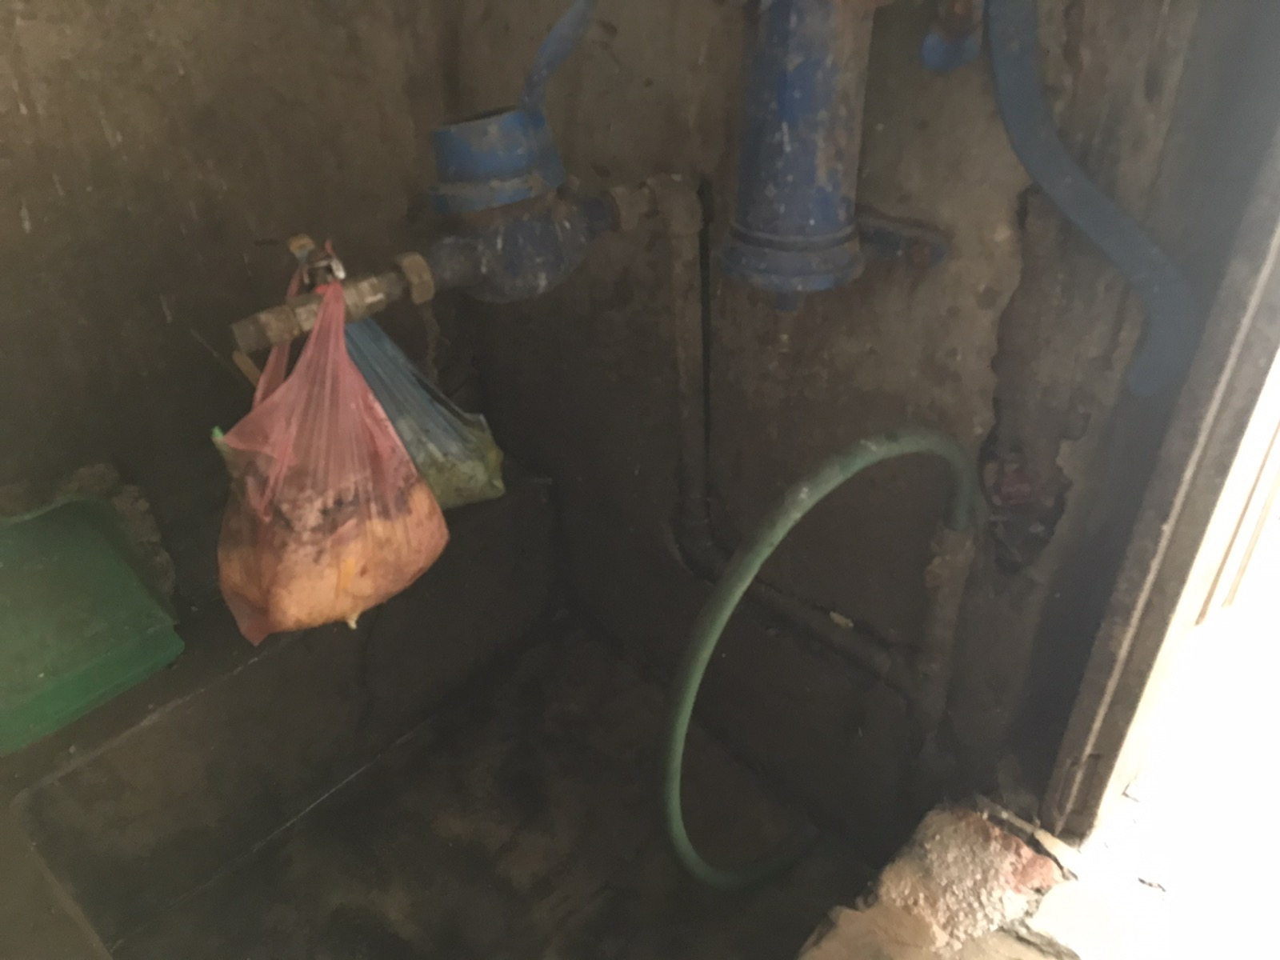
Illegal By Pass Line

Slide 13
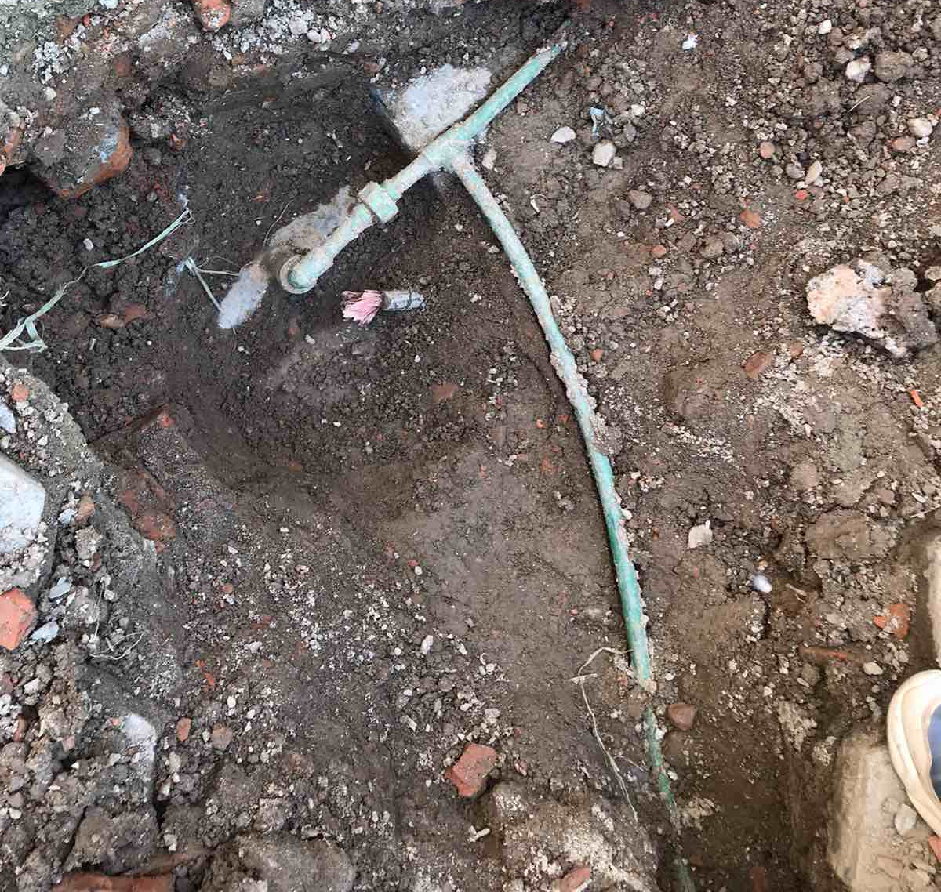
Illegal By Pass Line

Slide 14
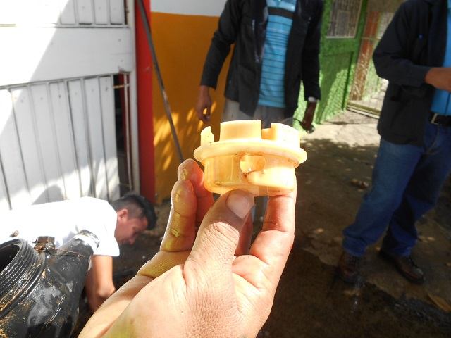
Meter Inaccuracies
Volume under-recorded by revenue meter due to its condition
Over-sized revenue meters
Meter tampering (water theft)

Slide 15
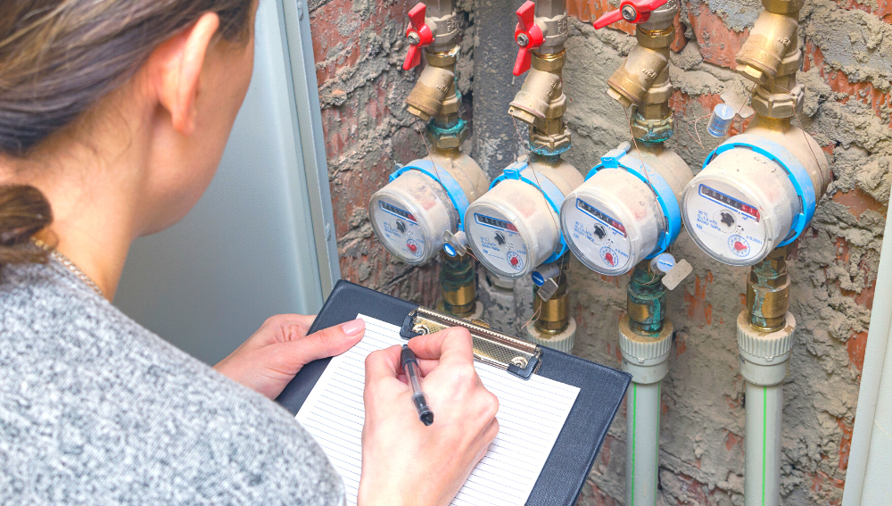
Meter Reading Errors
Corruption meter readers (collusion with customers)
Meter reading errors (mistakes, or unreadable meters)
Image Source: https://www.stsolutions.co.za/installing-individual-water-meters-for-sectional-title-complexes/

Slide 16
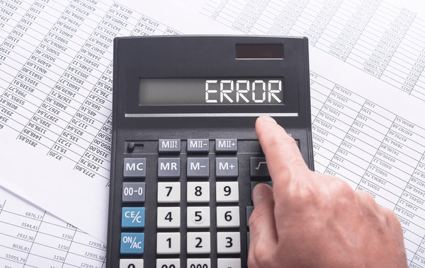
Accounting Errors
Data handling errors billing department
Bills sent to wrong address

Slide 17
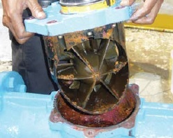
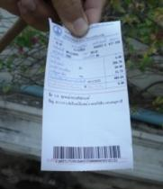
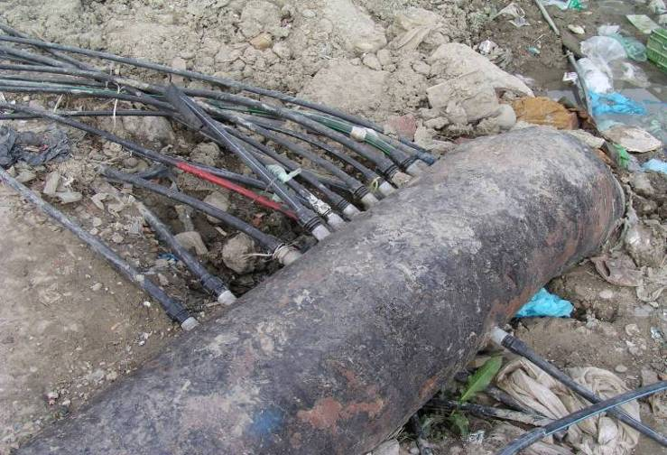
Four Approaches to Commercial Loss Reduction (Prioritising commercial loss approach)
Meter maintenance
Commercial Loss Reduction
Improve Billing Database
Meter reader awareness and training
Customer and local agencies’ awareness

Slide 18
Precaution measures contrary to meter reading errors
Corrective measures contrary to commercial losses in KUKL
Training to for meter readers to improve reading skill ,
Strict penalty and incentives to violating rules or corrupt staff,
Rotating meter readers to different routes regularly,
Public relations to improve meter reading condition

Slide 19
Precaution measures contrary to illegal connections
Promotion of public education for customers,
High penalty for illegal users,
Incentive to staff who found illegal users,
Use of modern technologies to find illegal users
Legalize unregistered water users in database as per connection policy

Slide 20
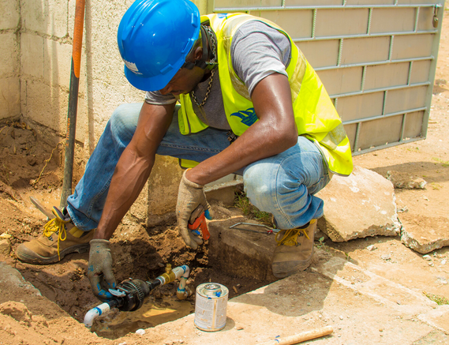
Precaution measures of inaccurate meters
Replacing defective meter
Improvement of meter installation skill.
Replacement of old damaged water meter to reduce NRW

Slide 21
Illegal connection (KUKL Connection policy 2011)
Any connection made to any of the water lines without the knowledge and approval of KUKL will be treated as an illegal connection. Illegal connections may be of the following types:
Connections not approved, under their normal procedures, by KUKL or their predecessors.
All self-reconnected connections of disconnected connections made without meeting the reconnection requirements.
Connections found without an intact meter seal.
KUKL may charge a penalty amounting to the total estimated billing for the period of illegal use and a surcharge of 50% to it. The minimum penalty in any case will be equivalent to 12 months of fixed monthly tariff for the connection type.
The connection will be legalized only after payment of the penalty and the regular fees for new connections,

Slide 22
Challenges and problems faced by KUKL
Challenges:
Proper detection of illegal connections and legalization work
Improving the accuracy of customer meter reading and ensuring that water consumption is properly reflected in bills
Implementation of commercial loss prevention measures based on the plan
Accurate understanding of non-revenue water

Slide 23
Problems:
Lack of enough manpower, specially the meter readers. Meter readers cannot go to each household every month due to heavy workload and insufficient.
Lack of proper guidelines for data entry for various situations not in place, huge arrears remained, lack of interest by the customers to take responsibility for metered connections.
The old network system is very unreliable and causes multiple leaks frequently, causing majority of the budget being spent on leakage repair alone.

Slide 24
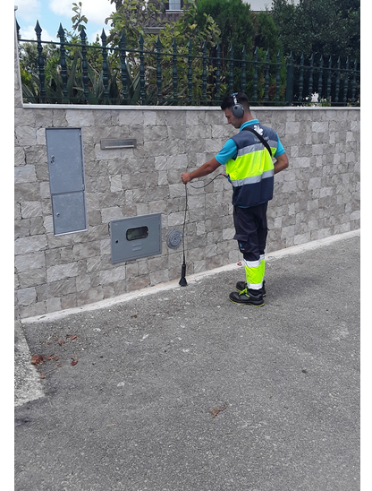
Developing an NRW Reduction Strategy for KUKL
Physical loss control strategy
Active leakage control
Pipeline and asset management
Speed and quality of repairs
Pressure management
Leak detection works to reduce NRW

Slide 25
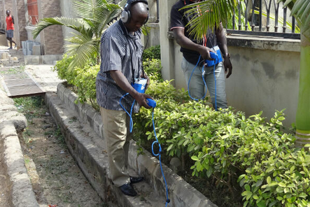
Commercial loss reduction strategy
Improving customer meter accuracy
Improving meter reading and billing i.e. 100% reading& billing
Detection of illegal connections and water pilferage

Slide 26
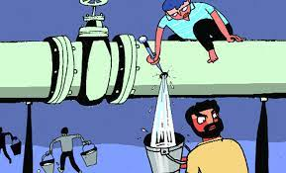
Summary
NRW is a waste of money
Reducing Commercial Losses generates revenue
Reducing Physical Losses reduces the costs of producing the water (chemical and energy reduction)
Reducing NRW improves the distribution system
Reducing NRW improves the aesthetic appearances of the city
NRW thus directly affects the capacity of water utilities to fund necessary service expansions, conduct proper maintenance and invest in new technology
NRW management in water utilities should be treated as a culture of the whole organization instead of a small department.

Slide 27
Thank you for your kind attention

